Slide 1
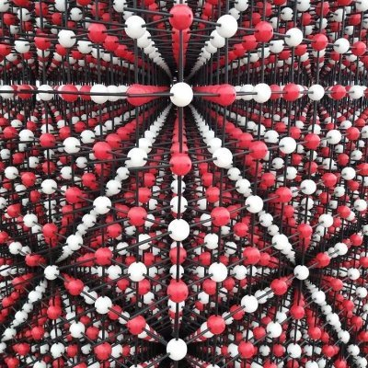
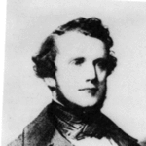
BPM: 2 Engineering Physics-II
UNIT –I: Crystal Structures and X-ray Diffraction
Lecture-3
By- Prof. B. K. Pandey, Dept. of Physics and Material Science
Auguste-Bravais

Slide 2
2D Unit Cell example -(NaCl)
We define lattice points ; these are points with identical environments

Slide 3
Choice of origin is arbitrary - lattice points need not be atoms - but unit cell size should always be the same.

Slide 4
This is also a unit cell - it doesn’t matter if you start from Na or Cl

Slide 5
- or if you don’t start from an atom

Slide 6
This is NOT a unit cell even though they are all the same - empty space is not allowed!

Slide 7
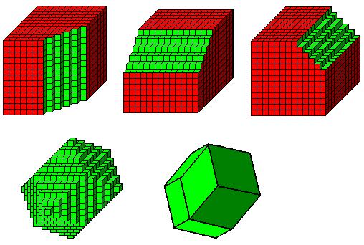
Unit Cell in 3D

Slide 8
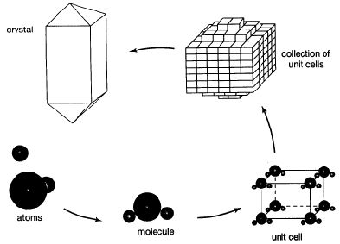
Unit Cell in 3D

Slide 9
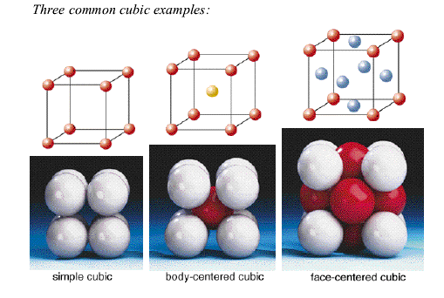
Three common Unit Cell in 3D

Slide 10
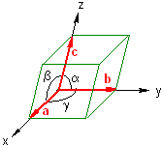

Unit Cell
The unit cell and, consequently, the entire lattice, is uniquely determined by the six lattice constants: a, b, c, α, β and γ.
Only 1/8 of each lattice point in a unit cell can actually be assigned to that cell.
Each unit cell in the figure can be associated with 8 x 1/8 = 1 lattice point.

Slide 11
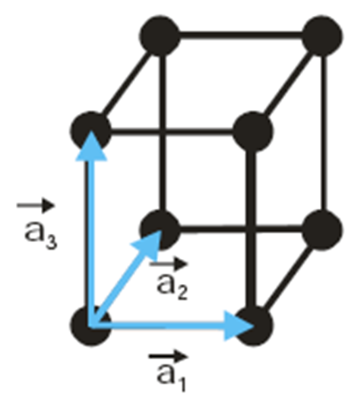
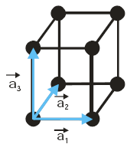
Primitive Unit Cell and vectors
A primitive unit cell is made of primitive translation vectors a₁ ,a₂, and a₃ such that there is no cell of smaller volume that can be used as a building block for crystal structures.
A primitive unit cell will fill space by repetition of suitable crystal translation vectors. This defined by the parallelpiped a₁, a₂ and a₃. The volume of a primitive unit cell can be found by
V = a₁.(a₂ x a₃) (vector products)
Cubic cell volume = a³

Slide 12
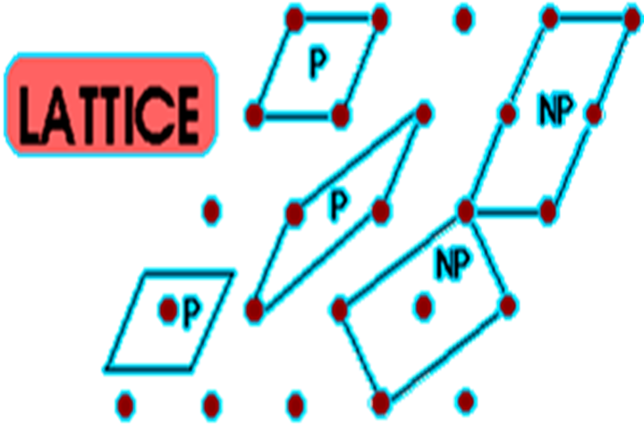
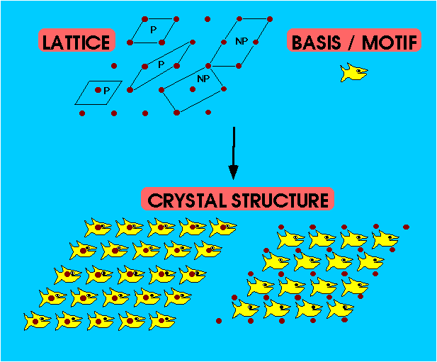
Primitive Unit Cell
The primitive unit cell must have only one lattice point.
There can be different choices for lattice vectors , but the volumes of these primitive cells are all the same.
P = Primitive Unit Cell
NP = Non-Primitive Unit Cell

Slide 13
3D – 14 BRAVAIS LATTICES AND THE SEVEN CRYSTAL SYSTEM
TYPICAL CRYSTAL STRUCTURES
There are only seven different shapes of unit cell which can be stacked together to completely fill all space (in 3 dimensions) without overlapping.
This gives the seven crystal systems, in which all crystal structures can be classified.

Slide 14
3D – 14 BRAVAIS LATTICES AND THE SEVEN CRYSTAL SYSTEM
Cubic Crystal System (SC, BCC,FCC)
Hexagonal Crystal System (S)
Triclinic Crystal System (S)
Monoclinic Crystal System (S, Base-C)
Orthorhombic Crystal System (S, Base-C, BC, FC)
Tetragonal Crystal System (S, BC)
Trigonal (Rhombohedral) Crystal System (S)

Slide 15
